Slide 1

Effects of segmenting, signaling, and weeding on learning from educational video

Slide 2


Authors
Pavlo D. Antonenko Associate Professor, Director, Neuroscience Applications for Learning (NeurAL) Lab University of Florida p.antonenko@coe.ufl.edu
Mohamed Ibrahim Associate Professor Curriculum Instruction Arkansas Tech University mibrahim1@atu.edu
Notes:
Mohamed Ibrahim is a PhD candidate in the Educational Technology program at Oklahoma State University. He currently works as a multimedia developer and faculty support specialist at Tulsa Community College.
Pavlo D. Antonenko is an Assistant Professor of Educational Technology at Oklahoma State University. He teaches courses on human-computer interaction and computer- based instructional development. His research focuses on the design of online environments for formal and informal learning.

Slide 3
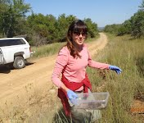

Authors
Carmen M. Greenwood Dept. of Fisheries, Wildlife and Environmental Studies SUNY Cobleskill greenwcm@cobleskill.edu
Denna Wheeler Clinical Associate Professor and Director of Rural Research and Evaluation Oklahoma State University denna.wheeler@okstate.edu
Notes:
Carmen M. Greenwood is an Assistant Professor of Entomology at Oklahoma State University. Her teaching and research focus on the area of Insect Ecology, primarily of soil-dwelling invertebrates.
Denna Wheeler is the Coordinator of Research and Evaluation for Oklahoma State University’s Center for Rural Health.

Slide 4


Introduction
Videos may require higher levels of cognitive processing.
A key challenge is to direct learners’ attention to relevant information.
This study examined the effects of three multimedia design principles (SSW) on undergraduate students’ learning outcomes and perceived learning difficulty in the context of learning entomology from an educational video

Slide 5
Introduction – The five assumptions
Cognitive architecture assumption – There is infinite long term and limited active processing memory
Dual Channel Assumption – Working memory has two structurally and functionally distinct - Visual and Auditory - processing channels
Limited Capacity Assumption – Each channel can process limited information at a time
Active Processing Assumption – We select relevant information, make cognitive structures, and integrate those with past cognitive structures
Cognitive Load Assumption – Three loads for learning – intrinsic, extraneous, and germane
Notes:
intrinsic load is the cognitive processing required to comprehend content, extraneous load is caused by ineffective formats of content presentation, and germane load, which is beneficial to learning, enables learners to engage in deeper cognitive processing of the to-be-learned material

Slide 6
Introduction
Signaling – main ideas are summarized and highlighted to aid learners in selecting relevant information.
Weeding – non-essential content is eliminated in order to allow students to engage in processing only the essential content.
Segmentation – learning material is broken up into several segments of information to help students process one cluster of related information elements before moving to the next one.

Slide 7
Hypotheses
Hypothesis 1 : Novice learners in the SSW (Signaling, Segmentation, Weeding) video group will report lower levels of learning difficulty than their counterparts in the control group.
Hypothesis 2: The SSW intervention will improve the overall knowledge acquisition (retention, transfer, and structural knowledge) of novice learners in the context of educational video.

Slide 8
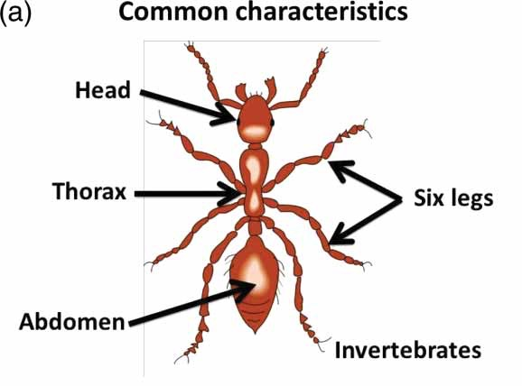
Method
Independent Variable:
Effect of SSW
Dependent Variables:
Perceived learning difficulty
Knowledge retention
Transfer of knowledge
Structural knowledge acquisition.
Covariates:
metacognitive awareness
prior knowledge

Slide 9
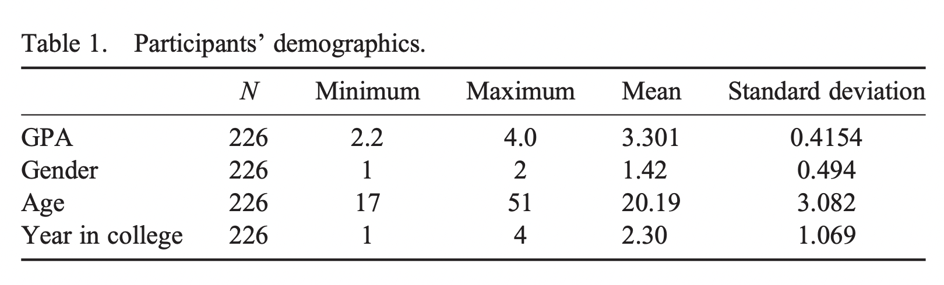
Method
Population:
226 undergraduate students
110 students in the SSW group
116 students in the non-SSW group

Slide 10
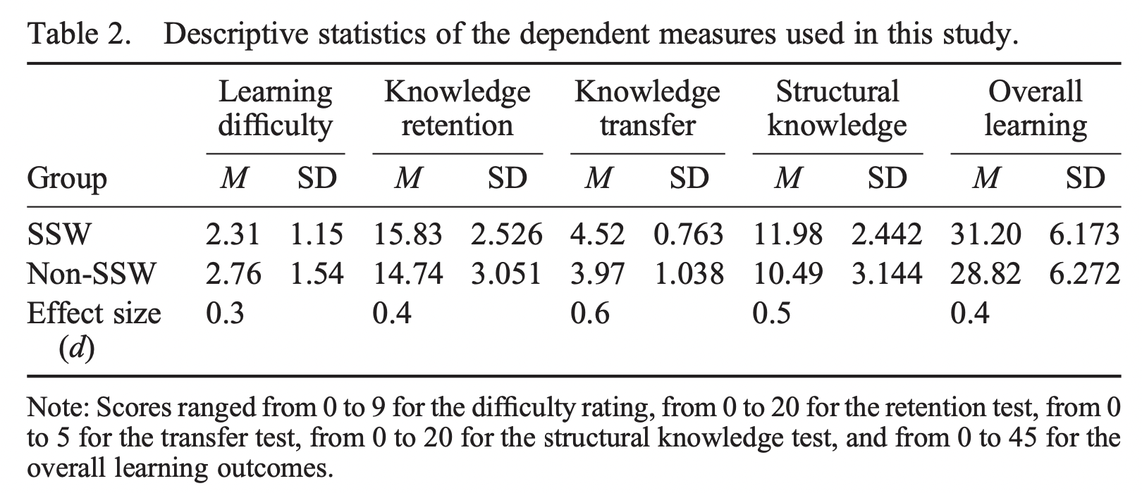
Results
Data Analysis using one-way between-groups multivariate analysis of covariance (MANCOVA)

Slide 11
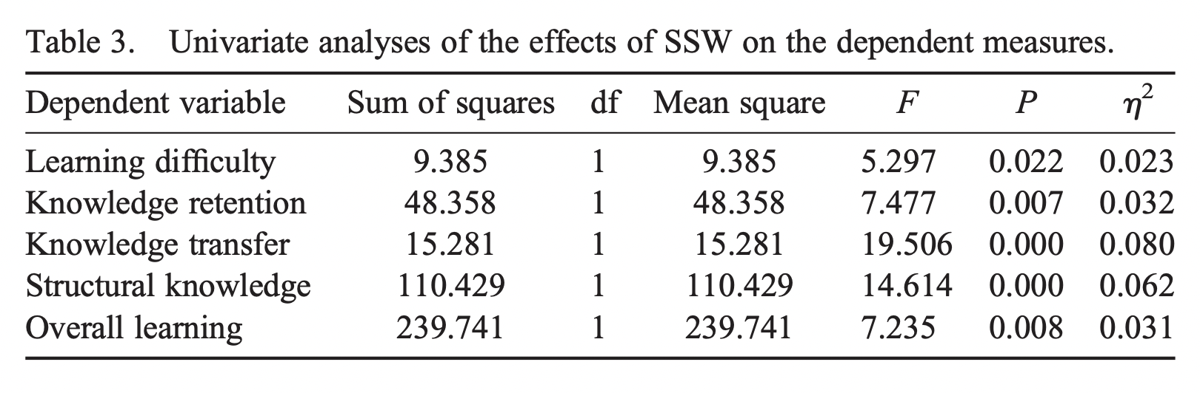
Results
Data Analysis using one-way between-groups multivariate analysis of covariance (MANCOVA)

Slide 12
Results – Hypothesis 1
The SSW group reported lower learning difficulty compared with the non-SSW group and that the difference was statistically significant. SSW intervention accounted for a 2.3% decrease in the perception of learning difficulty for students in the SSW group.

Slide 13
Results – Hypothesis 2
The SSW group performed higher on gaining overall knowledge, retention, knowledge transfer, and structural knowledge test compared with the non-SSW group, and the difference was statistically significant.
The SSW intervention accounted for a
3.1% improvement in the overall knowledge acquisition,
3.2% improvement effect in knowledge retention,
8% improvement in knowledge transfer, and
6.2% improvement in structural knowledge acquisition
for the participants in the SSW group.

Slide 14
Discussion and Critique
Too short experience sample
Only one video
Entomology context
Unknown questionnaires
Twenty marks MCQ Design for assessment
Coin-toss assignment
Prior Knowledge misrelation
Citations

